Slide 1
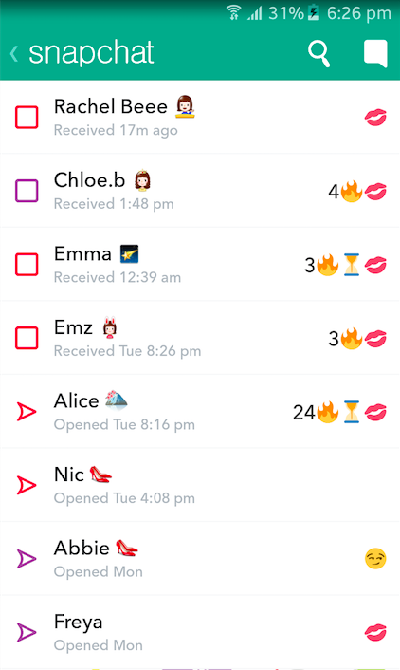
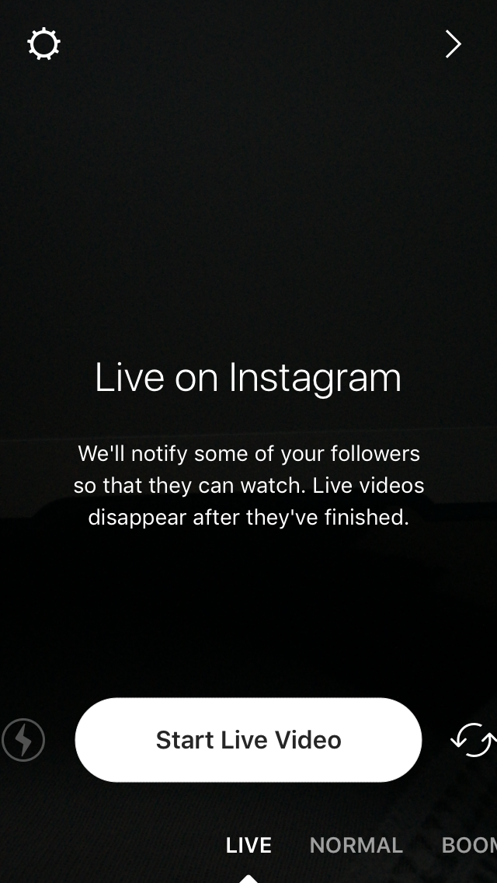
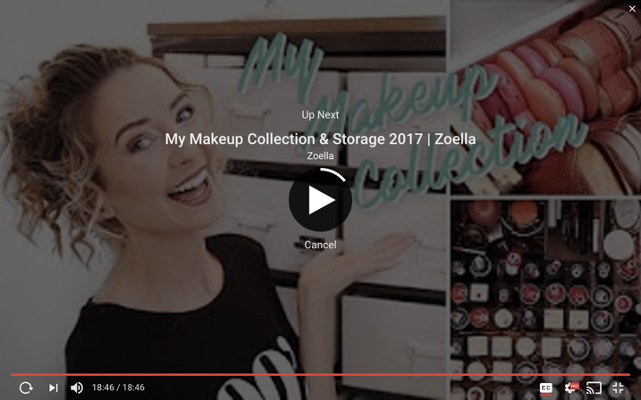


Tech control
Live Your Life
Addictive by Design? | Appendix 3
Snapchat ‘Streaks’
‘Read Receipts’ on Whats App
Instagram ‘Live’
‘Up Next’ on YouTube
Copyright: Zoella YouTube Channel
Copyright: The Parent Hub
#TechControl
A series of classroom resources created to help promote the healthy and positive use of technology.

